Slide 1
Data Engineering Final
Prachika Agarwal - pa2191

Slide 2
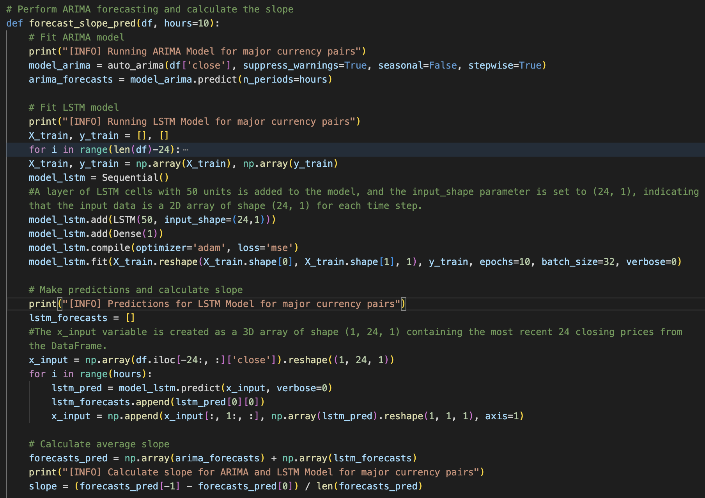
Improving the prediction algorithm to choose the currency pairs to go long and short
Used ARIMA Model and LSTM Model to calculate average slope
ARIMA or AutoRegressive Integrated Moving Average. It is a time series forecasting model that is used to predict future values of a time series based on its past values.
LSTM model is a type of recurrent neural network that can process sequential data and is commonly used for time series forecasting and natural language processing tasks.
This function fits both an ARIMA and an LSTM model on the historical data, makes predictions for the future, combines the predictions, and calculates the average slope of the combined predictions. The slope is calculated by finding the difference between the first and last predicted values and dividing it by the number of predicted values.
Improvement from Assignment 5:
Added LSTM along with ARIMA model to improve slope calculation
Benefits: makes the model robust, improves accuracy and adaptability for a better average slope calculation
Suggested pair: Long - NZD_JPY (slope: 0.05)
Short - GBP_JPY (slope: -0.15)

Slide 3
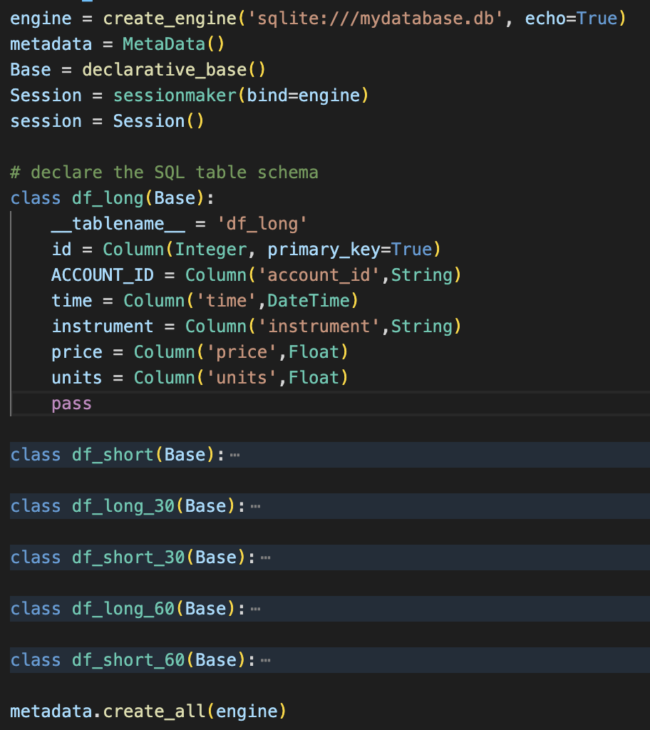
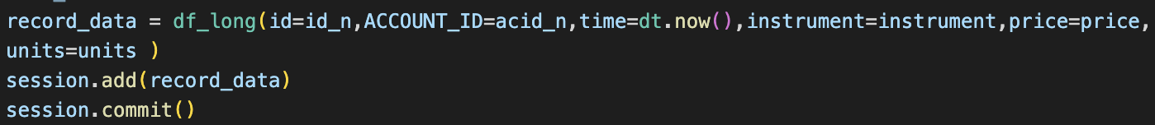
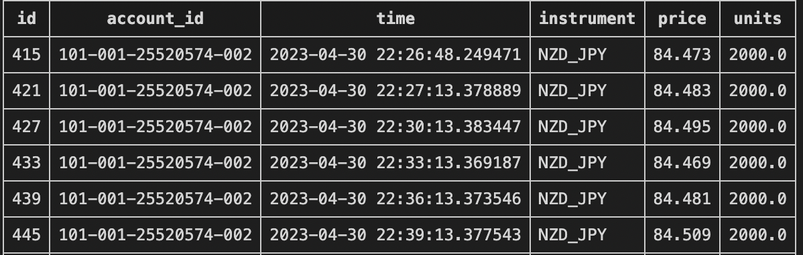
Storing the data SQL Alchemy database
Created 6 tables - df_long, df_short, df_long_30, df_short_30, df_long_60, df_short_60
Create an SQL Lite database using SQL Alchemy, declare the base, engine.
Create classes and define our tables for each execution block, define the table schemas, after defining the table schema, create all the tables
An example of how the tables look like:
An example of how we add values into our tables

Slide 4
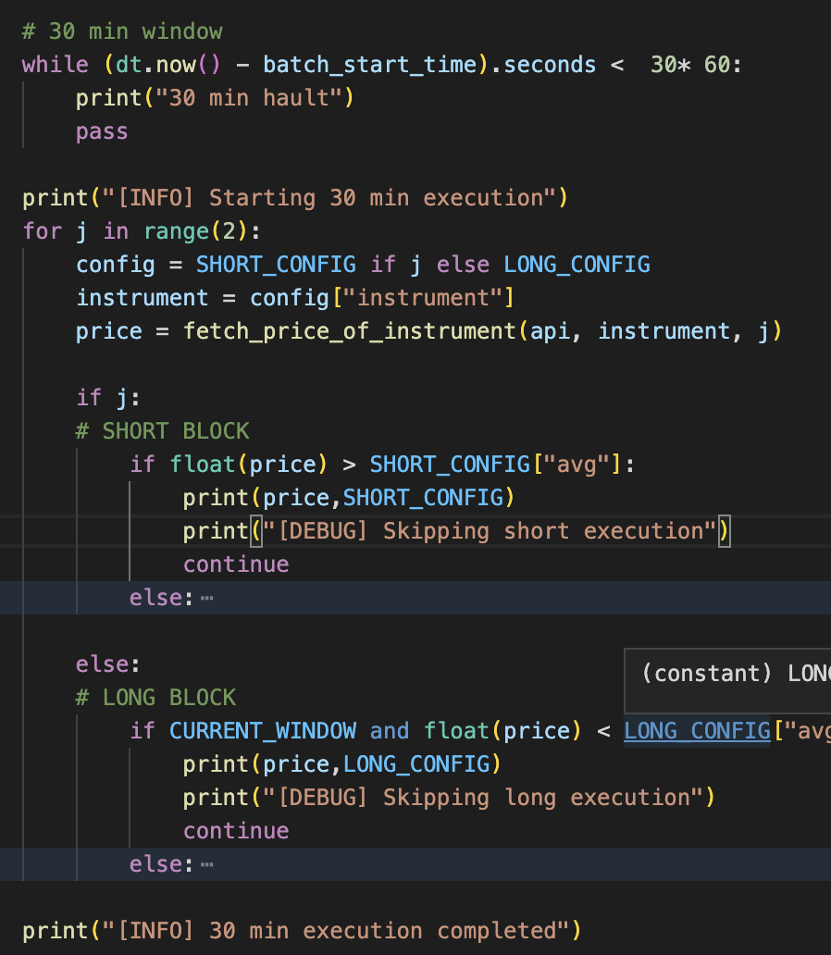
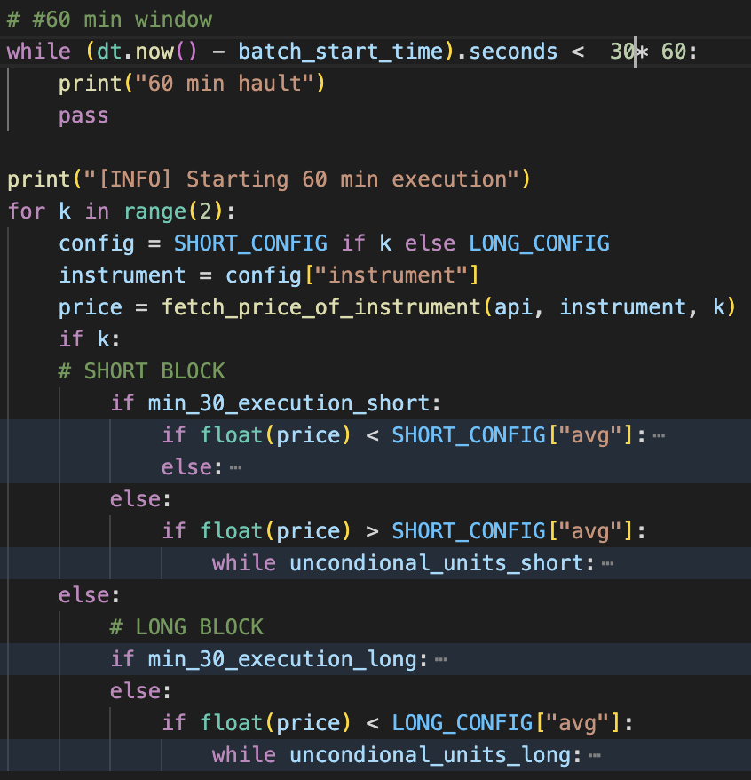
Extension
Extending the code to continue execution 30 min and 60 min after the last execution block
At the beginning of the 30 min window we maintain two flags: min_30_execution_long and min_30_execution_short which are set as false.
In the 30-minute phase, it fetches the current price of an instrument and based on the configuration, either buys or sells units of that instrument, if the 30-min window is executed we reset the flag value to True
In the 60-minute phase: the code uses the flag to check if any units of the instrument were not executed in the previous phase and executes the remaining units either as a buy or sell order based on the current price.
1st Window (10pm-11pm): Executed currency pairs, Average Price: Long Pair (NZD/JPY) 84.51, Short Pair (GBP/JPY) 171.80
2nd Window (11pm-12am): Observation: For both Long Pair and Short Pair the prices were going high.
Executed units: Long Pair - 57,000, Short Pair - 0, Unexecuted units: Long Pair - 3,000, Short Pair - 60,000. Average Prices: Long Pair - 84.59, Short Pair - 171.80
3rd Window (12am-1am): Observation: For both Long Pair and Short Pair the prices were going high.
Executed units: Long Pair - 97,000, Short Pair - 62,000, Unexecuted units: Long Pair - 3,000, Short Pair - 1,238,000. Average Prices: Long Pair - 84.619, Short Pair - 171.808
4th Window (1am-2am): Observation: For both Long Pair and Short Pair the prices were going high.
Executed units: Long Pair - 157,000, Short Pair - 8,749,000, Unexecuted units: Long Pair - 3,000, Short Pair - 17,371,000. Average Prices: Long Pair - 84.63, Short Pair - 171.804

